Slide 1

VOTEGRITY
0
2
Student 1: Thomas Kelly
Student 2: Rishabdev Sidhu
Supervisor: Prof Geoff Hamilton
1
3

Slide 2
VOTEGRITY
0
1
Student 1: Thomas Kelly
Student 2: Rishabdev Sidhu
Supervisor: Prof Geoff Hamilton
2
3
Notes:
Introduce the project and ourselves

Slide 3

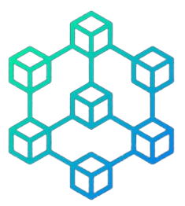
Motivation
Recognition of vulnerabilities in modern voting systems
Innovative Blockchain Technology

Slide 4
Motivation
Recognition of vulnerabilities in modern voting systems
Innovative Blockchain Technology
Notes:
For our 4th year project, we wanted to go above and beyond by exploring new and technologies such as blockchain and challenge ourselves to become better.
We recognised that traditional voting systems were too old school, had multiple vulnerabilities that allow for tampering of votes and therefore making the voting system untrustworthy because what's the point if your vote means nothing.
We realised that with blockchain's transparent and immutable technology, we could incorporate a new and modernised system for voting, one in which the user can vote without doubt.

Slide 5


Proposed Solution
Cryptographic security
Blockchain Voting System

Slide 6
Proposed Solution
Cryptographic security
Blockchain Voting System
Notes:
Then we came up with Votegrity, the innovative blockchain-based voting system designed to enhance the transparency, security, and accessibility of election processes.
Votegrity prioritizes user privacy and trust, employing cryptographic techniques to safeguard sensitive information and accommodates various authentication and verification methods.

Slide 7







Research
Password security
Tokenisation
AWS Key Management Storage
Homomorphic Encryption
Server Vulnerabilities
Blind Signatures
Programming Languages
& Tools
Vote Encryption

Slide 8
Research
Password security
Tokenisation
Programming Languages
& Tools
AWS Key Management Storage
Homomorphic Encryption
Vote Encryption
Server Vulnerabilities
Blind Signatures
Notes:
There was quite a bit of research involved prior to and during the coding process
New languages and frameworks we hadn't used or looked at ever before, displayed on the next slide
We researched how to use tokenisation to authenticate users for every request without having to sign in
How to securely send passwords from the frontend to the server without exposing it to man-in-the-middle attacks and store it in the database in a way that even if the database is exposed, the user's password cannot be known
Look at possible options on how to store the admin's private key securely so that it can never be exposed
Possible server vulnerabilities and how to overcome those problems
How to encrypt the vote/votes into one single number so when it is tallied it's possible to decrypt it back to the original vote or set of votes
How to tally up the votes using homomorphic addition and multiplication
How to blind and sign each vote

Slide 9












Technologies
ZAP
Postman
Vue js
Vuetify
Web3 js
AWS
Docker
Node js
EVM
Hardhat
Express js
MySQL
Solidity

Slide 10
Technologies
Docker
AWS
ZAP
Postman
Web3 js
EVM
Hardhat
Vue js
Vuetify
Node js
MySQL
Solidity
Express js
Notes:
We used a diverse range of technologies, frameworks and tools to design the system
[Describe each tech tool and their function]

Slide 11

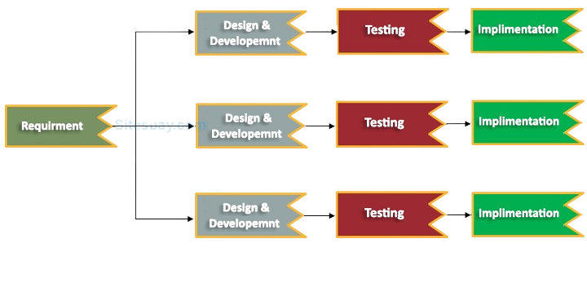
Process
Agile Scrum
Incremental Model
Kanban Board

Slide 12
Process
Agile Scrum
Incremental Model
Kanban Board
Notes:
We needed a flexible and iterative approach to manage our development process efficiently, allowing us to adapt to changing requirements and deliver high-quality results within tight deadlines.
Therefore, we chose the Agile Scrum framework, complemented by a Kanban board
We used Jira during our INTRA placement and found it to be very helpful so we incorporated the same into designing the system

Slide 13
Contributions
Thomas Kelly | Both | Rishab Sidhu
Smart Contract | Backend | Frontend
Blockchain network | Vote Encryption | Server Protection
AWS KMS | Vote Decryption | Tokenisation
Blind Signatures | Homomorphic encryption | Docker
Ethereum Wallet | Technical Manual | Sequelize
Atlas | Functional Specification | Database Normalisation
Idea | Testing | User Manual
 |  | Frontend guidelines

Slide 14


Testing
Unit Testing
Integration Testing
System Testing
Security Testing
User Testing
Automated Testing

Slide 15
Testing
Unit Testing
Integration Testing
System Testing
Security Testing
User Testing
Automated Testing
Ad Hoc Testing
Notes:
Document on test cases
Following testing

Slide 16
Demonstration

